Slide 1



Almasi Heights International
School
www.almasiheights.com

Slide 2


A Message From The Founders
Thank you for considering joining Almasi Heights.
Almasi Heights is nestled on a Hilltop in the small rustic town of Meka, in Embu County, 30 kilometers from the main town. Here, we intend to establish a community of the next generation of leaders. Purpose Driven Youth leaders.
By Entrusting your children to us, we commit to empower them, through love and guided compassion , so that they can inspire the world. Our approach to education is not traditional. We believe in 3 things:
We will build a strong foundation: We are all about the Child's growth. Nurturing their talent, their inborn gifts and showing them how to use it for good as God intended.
Our Approach is holistic: Focused on experience and Relationships. We encourage the child to think through issues and creatively, through projects, contribute to the society at large. This will be accomplished through participation in events, community service and projects in and out of the country.
Our curriculum is designed to support a child develop and find meaning in their existence - we provide a stable and intentional approach to help them develop a Godly and Impactful self image, and thus they'll grow being consequential to the world.
Write to us on admissions@almasiheights.com and we will set up a call. Let’s chat about your child growing with us. Admissions open from PreK- Grade 5. Grade 3 -5 (8years- 10 years) is boarding only.
Makena & Bella
Welcome to

Slide 3

About Our School
Join Us, at Almasi Heights
Almasi Heights International is a Christian school offering the ACE Program (American). From Grade 9-12, our students will progress to the ICCE Curriculum.
It is a private Christian school based on Adventist virtues, and all faiths are welcome.
We serve students from Grade PreK-12, with boarding facilities from Grade 3 (8 years and above).
Admissions ongoing for
PreK (Below 5 Years)
Kindergarten – 5 Years
Grade 1 – 6 Years
Grade 2 – 7 Years
Grade 3 – 8 Years (Boarding Only)
Grade 4 – 9 Years (Boarding Only)
Grade 5 – 10 Years (Boarding Only)
Grade 6 - 11 Years (Boarding Only)

Slide 4


Why Almasi Heights?
Share Love
& Kindness
Our students are encouraged to discuss ideas with genuine intellectual inquiry and Christian charity. We equip our students to make good decisions, grounded in the faith; to face the challenges of the real world, without being sheltered from them; and to impact others for God’s glory.
At Almasi, extra-curricular and co-curricular programs are an integral part of the educational experience.
An Almasi Heights education prepares students to read insightfully, think critically, solve problems logically, and communicate effectively within the framework of a Biblical worldview.

Slide 5

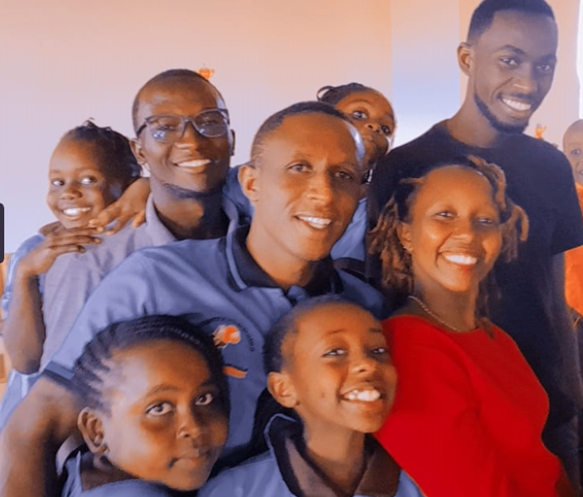

Our Values
At Almasi Heights, we bring Purpose to Learning. We encourage our students to discover their gifts and make their contribution in the world.
We believe in taking our right place to support our students to grow into the next generation of Leaders.
Purpose Driven Leaders, transformed from within, who will inspire the world.
Join our FIAC (Fierce) TEAM.
We are F-I-A-C
Focus
Integrity
Ambition
Courage
Philippians 4:8
Colossians 3:23
James 3:13
Habakkuk 2:2-3
Joshua 1:9

Slide 6




Our Learning Philosophy
Core curriculum drawn from classical Christian liberal arts & sciences tradition which emphasizes reading, writing, speaking and reasoning skills at every level- with minimal specialization
Comprehensive, challenging, college preparatory academic program providing coursework necessary for acceptance into competitive colleges and universities
Balanced Curriculum – rigorous and engaging, utilizing best instructional practices (age- appropriate, multi-modal and brain-researched strategies)
Class sizes small enough to provide individualized attention
A Great Future, starts with an Almasi Heights Foundation
To Enroll your child
Admissions
admissions@almasiheights.com
Call Us
01 05 05 4141

Slide 7
Spiritual/Character Formation
Provide a safe and nurturing, grace-filled, Christian environment
Provide an atmosphere of mutual respect
Encourage the development of authentic spiritual disciplines/maturity through Bible curriculum and community service
Train the whole student to think, act, and serve with Christ-like character
Administer discipline in grace and love
Motivate students to serve their community, nation, world
How to Apply. - Please send a request to admissions@almasiheights.com
Admissions on going for PreK-Grade 5 only
Local Scholarships: For deserving local students, who are not able to otherwise access an Almasi Heights Education. Reach out, lets talk about a payment plan.
Scholarships
Self Funded :
10%

Slide 8
Play Group - Grade 2: Personal Items List
Toothbrush
Toothpaste
Rubber shoes (black)
Swimming costume
Crocs
Gumboots
Comfortable black school shoes
Back pack
If your child is not potty trained, please pack pampers and wipes daily sufficient for their use. If not sufficient, we shall bill you extra for provision of the same.
We will provide wholesome, healthy meals, with moderate snacks for the students. Do not pack any snacks or food for them
Please do not provide breakfast for the child at Home in the morning, they will eat in school.
On return Home, Please ensure they shower immediately, and eat dinner to prevent them sleeping hungry at night, as they will be quite exhausted

Slide 9
Grade 3-5: Personal Items List
Raincoat
Gumboots (for agriculture)
Toiletries (Toothpaste, Toothbrush, black shoe polish, shoe brush, Coconut oil/Vaseline, comb, soaps, sunlight washing power, cotton briefs (5), sanitary towels for girls above 10 years & other personal effects)
Tissues 2-10 packs,
Pyjamas/ Nightdress
Showercap (girls)
Comfortable black school shoes
Rubber shoes (black)
Slippers
Crocs
Bible – KJV
Swimming costume/Trunks
2 track suits (any color)
School bag/Backpack
Please note that you can pack home vests, dresses, tights/trousers for your child in Boarding. We do not accept torn jeans/ revealing or see through clothes.
We will provide wholesome, healthy meals, with moderate snacks for the students. Do not pack any snacks or food for them.
You are free to come visit your child on any weekend of your choice.
During the visits, if you choose, you may bring fruits - which will be shared by all children

Slide 10
The End

